Slide 1

DriverPass System Analysis
Travis Erwin
Notes:
[No speaker notes required for this slide.]

Slide 2

System Requirements
The system will allow users to login with their own accounts.
It will allow students to take practice exams, schedule driving lessons, and check their progress towards the goal of becoming a licensed driver.
It will allow administrators to access and edit data from all students and scheduled lessons.
It will also allow the DMV to update practice tests.
It should run on all web capable devices.
Data will be viewable for Liam even without an internet connection.
It should be safe and secure, encrypting passwords and only allowing authorized users to modify data in the system.
Notes:
The system requirements are a mix of functional and nonfunctional requirements. Some functional requirements for the system will be letting the users log in with their own personalized account. As a student, they will need to call DriverPass and speak with a secretary who will then help them create a username and password to access the system. As an admin or as Liam, they will have full access to all user data as well as capability of editing user data and disabling packages to sign up for.
Students will be allowed to take practice exams, schedule driving lessons, and check their progress to see just how ready they are for the DMV exam. To ensure the system is up to date with actual DMV tests, the DMV will upload updates to make sure everything the student learns will help them on their journey to become a licensed driver.
There will be requirements that don’t necessarily relate to the functionality of the system. One being that the DriverPass site will run on all web capable devices. It will store data from the previous connection for Liam so he can view it from anywhere even without a web connection. Logins will be safe and secure, passwords will be encrypted and only authorized users will have administrative access.

Slide 3
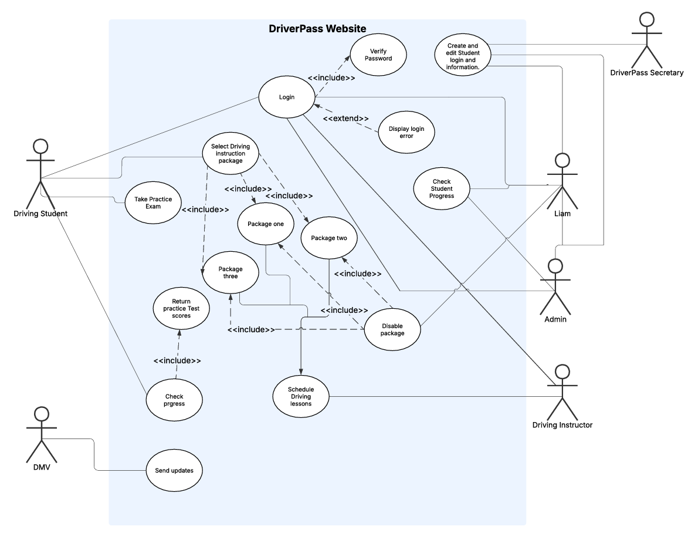
Use Case Diagram
[Insert your use case diagram here.]
Notes:
This Use Case Diagram shows all the potential actors within the system and how they will use it. The actors in this system are Liam, Administrators, a DriverPass Secretary, a driving instructor, the DMV, and the student.
The driving student will be able to log in, schedule driving lessons, take practice tests, and view their progress. Liam will be able to login, check student progress and disable packages as well as create and edit user login information in the case of a lockout due to multiple incorrect passwords or forgotten password. An admin will login and be able to check student progress as well as edit user information. The DriverPass secretary will be able to create logins for students. A driving instructor will be able check scheduled lessons with students, and the DMV will be able to update practice tests.

Slide 4
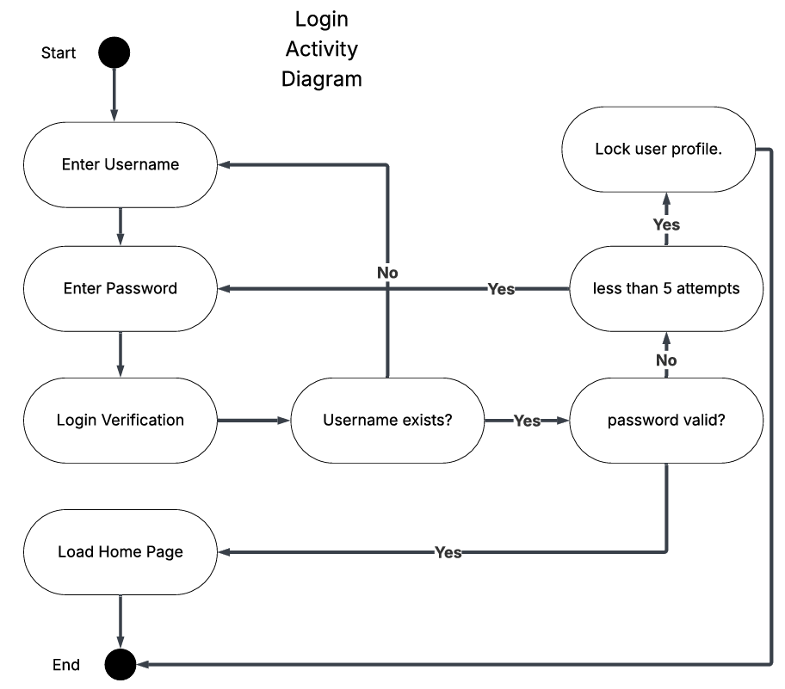
Activity Diagram
Notes:
This use case diagram shows how a user will login to the system. They start by entering their username, then password. The system then checks if the username exists and then validates the password, leading the user to the home page of the system. If the username doesn’t exist, then the user is directed back to the login screen prompting them for the username. If the password is invalid the user is redirected to the login screen to enter their password, if the user fails to enter the correct password after 5 attempts, then they are locked out of the system.
I felt DriverPass needed a bit of security in this process, so I added in a lockout if the user failed to enter the correct password after 5 times.

Slide 5
Security
Login lockouts after 5 failed attempts
Encrypted Passwords
Only authorized users can access sensitive data
Data transmitted between clients and the server will be encrypted using HTTPS encryption
Notes:
When designing the system, security was a large factor. DriverPass will be handling sensitive information, and it is our job to protect that information. We will be using industry standard practices to ensure all data being transferred is encrypted and only viewed by those who are allowed to view it. Login lockouts will be part of the system to protect against any brute force hacks into a user’s profile.

Slide 6
System Limitations
Offline capability will be limited to read only to avoid creating duplicate data.
DriverPass vehicles and teachers are limited so scheduling will be first come first serve.
No budget specified but it is assumed since DriverPass is a small company, they want to keep the overhead small.
Admins must be able to edit user info on the front end level to avoid any hard coding or SQL querying
Notes:
Liam wants to be able to access information while offline, though he will not be able to edit anything offline to prevent any duplication of data.
There are only so many cars and teachers available, so scheduling is first come first serve.
With no specified budget and the assumption that DriverPass is a small company, then keeping the overhead low will be a priority. This could result in skipping some planned functionality.
Administrators need to be able to edit user info without needing to know how to code or query a database.

